Slide 1
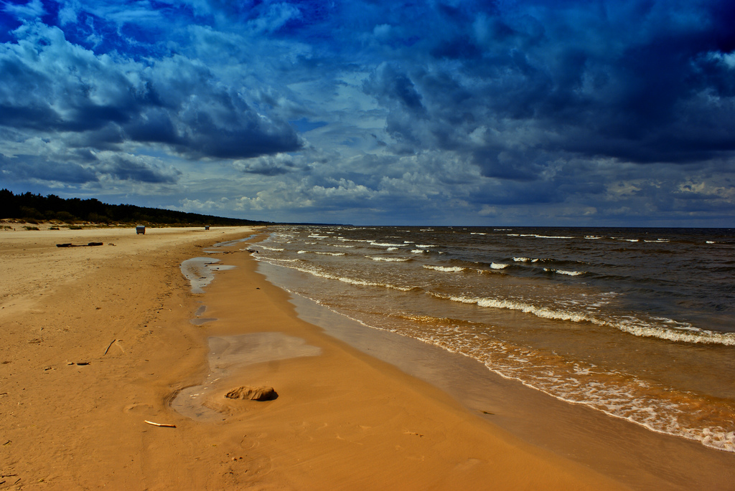
CHANGES IN THE BALTIC SEA IN THE LAST 25 YEARS SCIENCE OF CHANGES Katarina Oganjan 05.06.2015 TALLINN

Slide 2
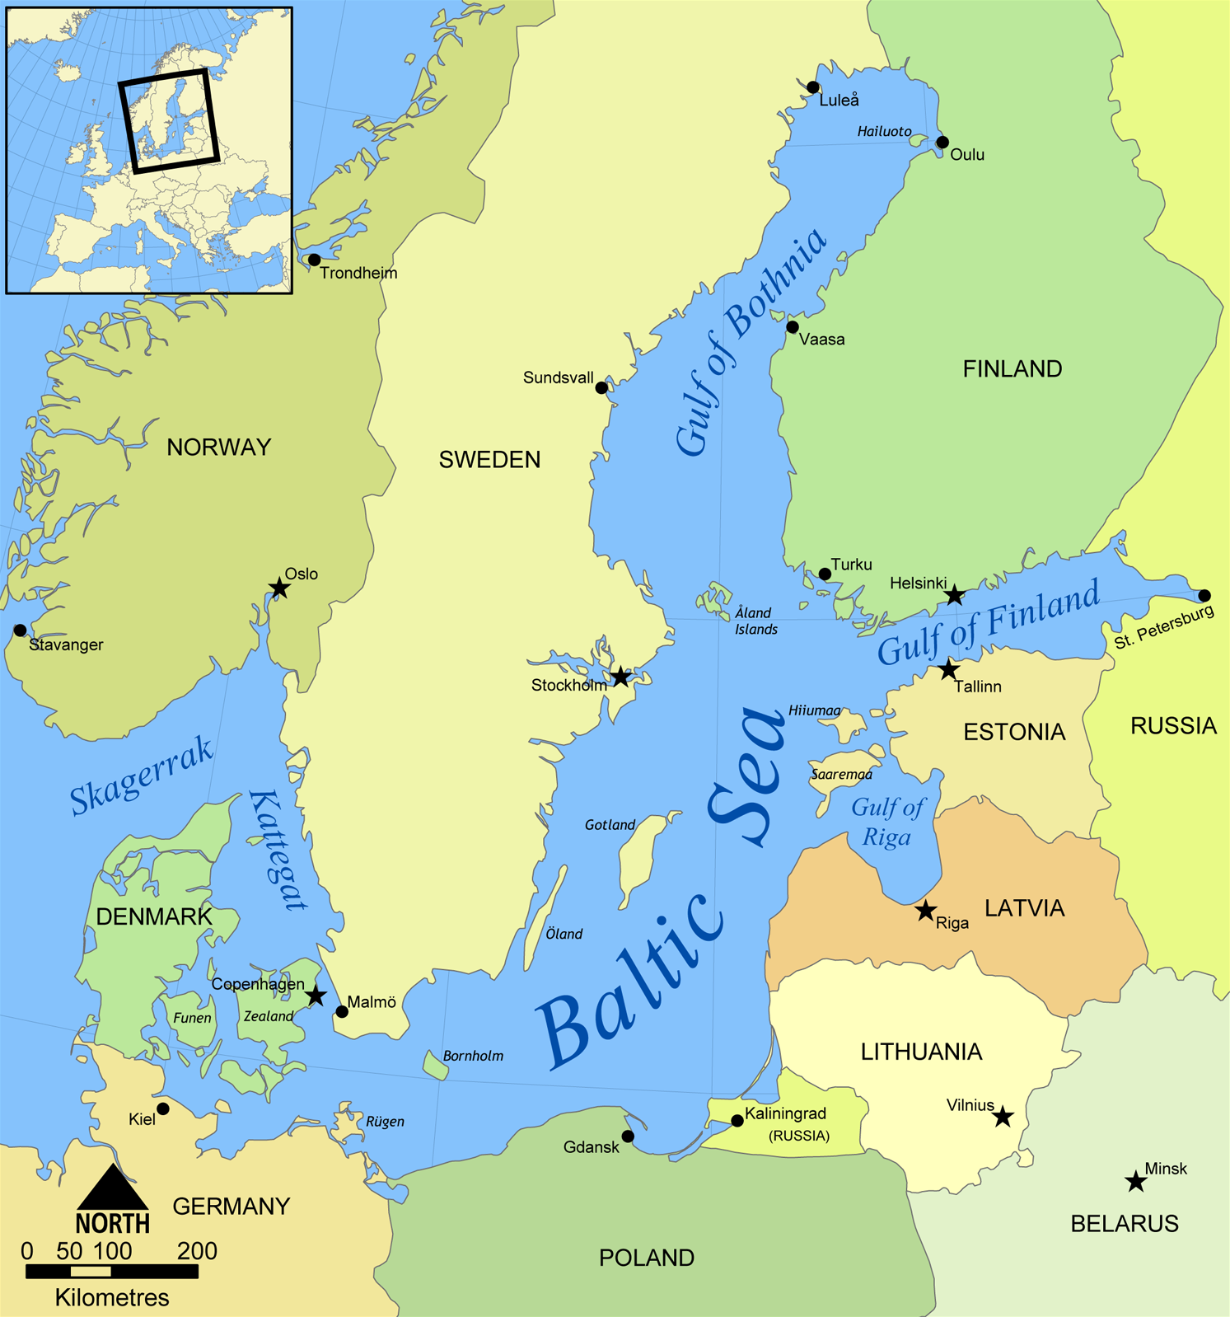
LAND LOCKED
BRACKISH
SHALLOW – 459 M
NONTIDAL

Slide 3
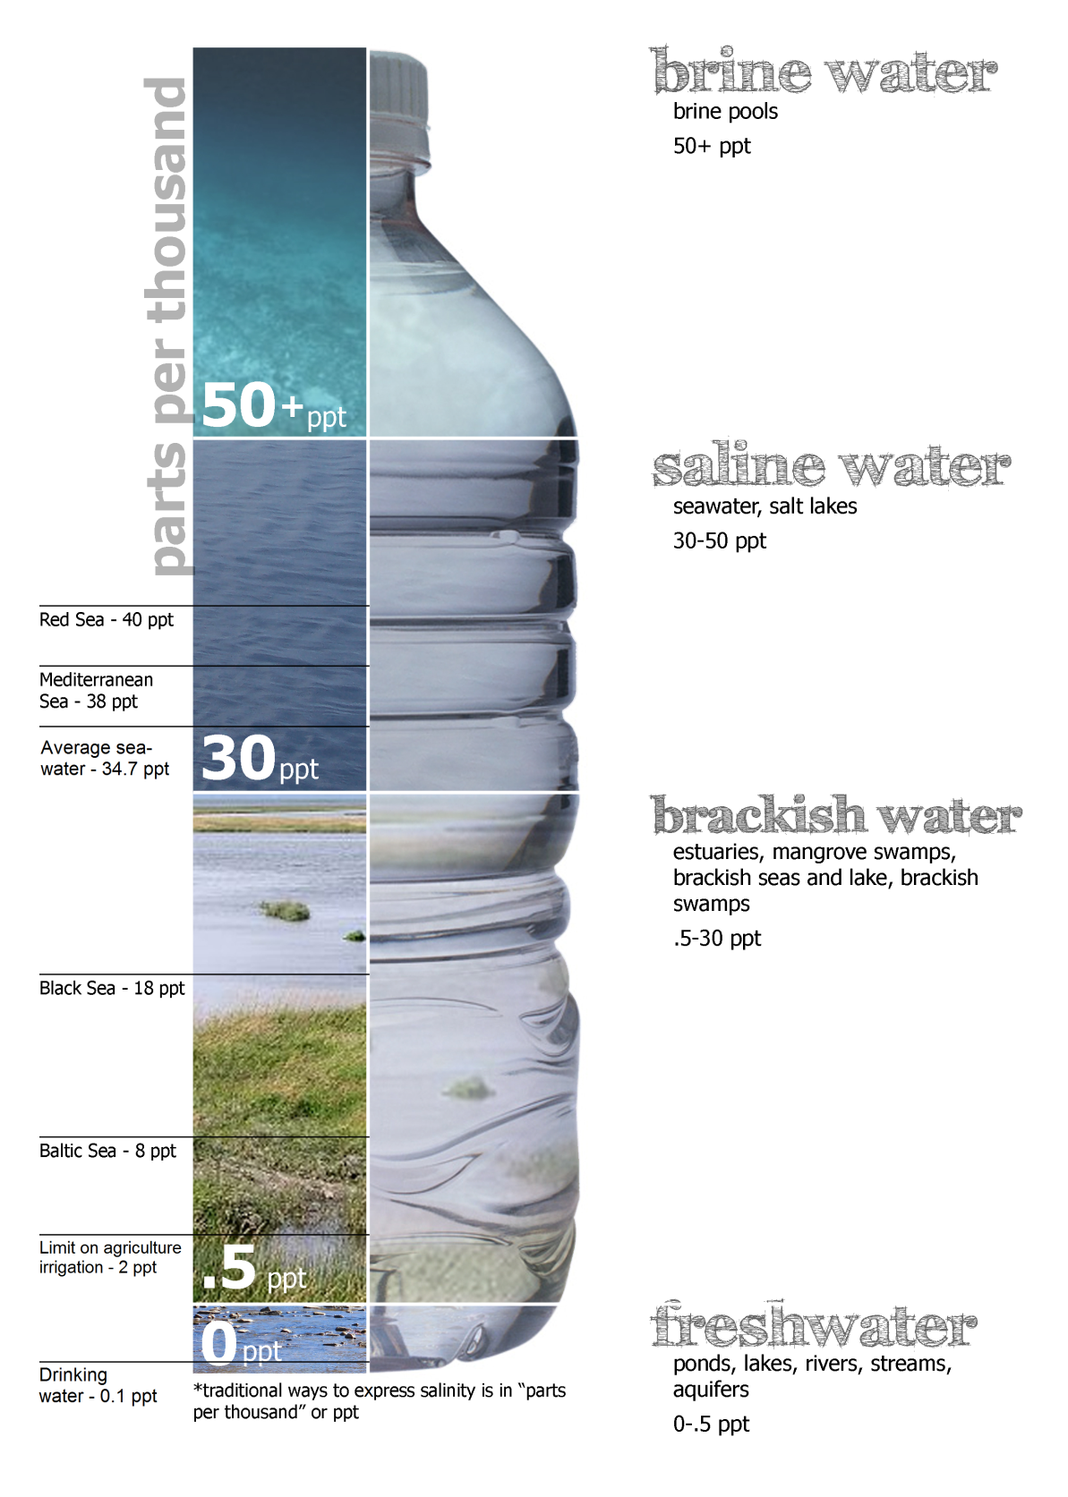
BRACKISH WATER
SALINITY 8

Slide 4
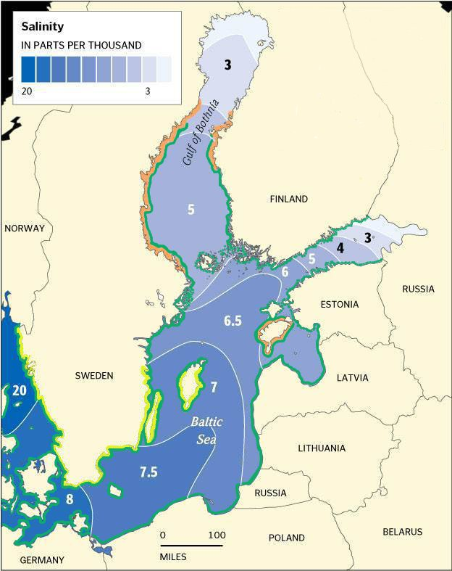
SALINITY GRADIENT
FROM BOTHNIAN BAY
TO THE DANISH STRAITS
WATER STAGNATION
25-40 YEARS

Slide 5
LAND LOCKED
BRACKISH
SHALLOW – 50 M
ON AVERAGE

Slide 6
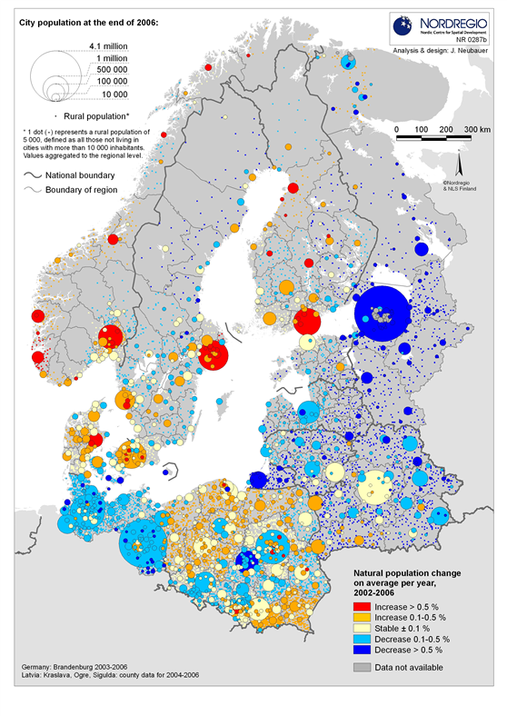
1900: 50 MILLION PEOPLE
1990: 80 MILLION PEOPLE
2015: 90 MILLION PEOPLE
Notes:
So it is a very shallow sea but at the same time it is a very big sea. And there are at the moment 90 million people living around it. And the population is increasing very quickly. In the beginning of the last century it was 50 million and with 100 years it has doubled! And as you might already know people influence nature in unimaginable ways. So all those 90 million people living around the Baltic Sea influence the Baltic Sea a lot. And in the last 25 years a lot of problems have surfaced. So now I am going to tell you about the problems that the Baltic Sea has.

Slide 7
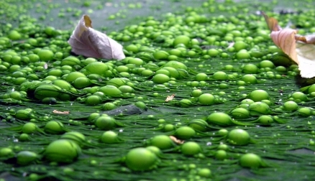
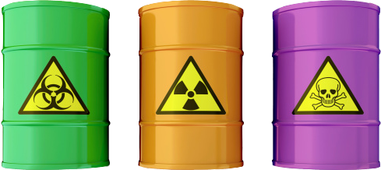
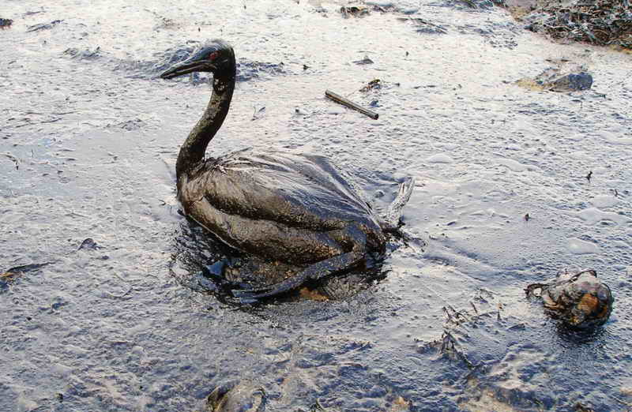
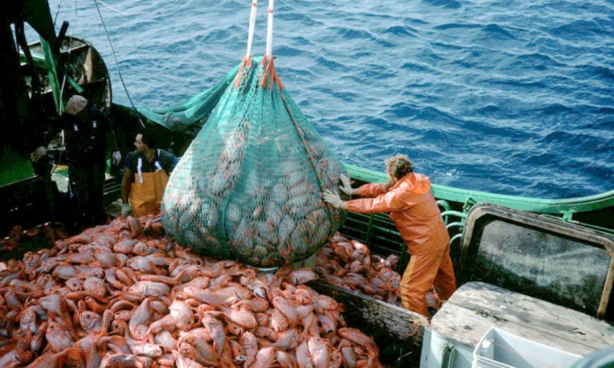
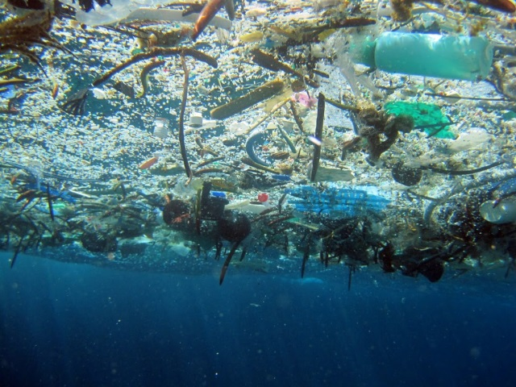
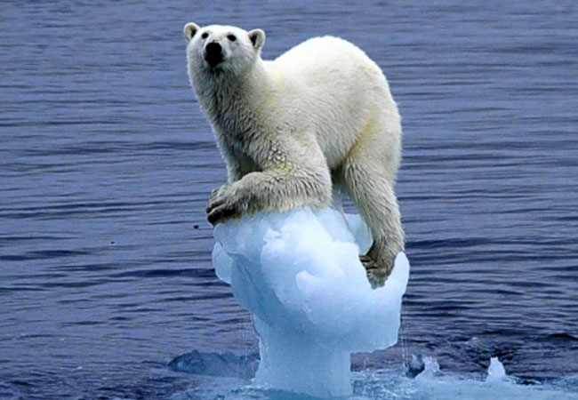
EUTROPHICATION
HAZARDOUS CHEMICALS
OVERFISHING
OIL
SPILLS
MARINE
LITTER
CLIMATE
CHANGE

Slide 8
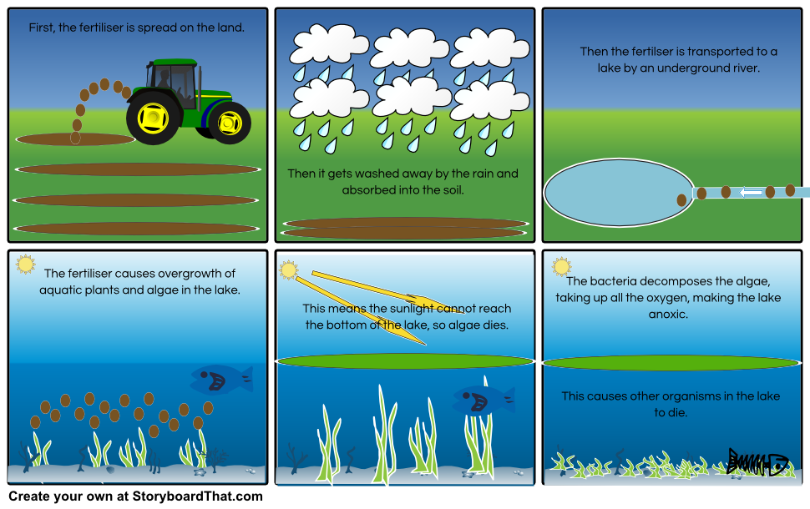
EUTROPHICATION
The fertiliser is transported to the sea through rivers
The fertiliser promotes growth of plants and algae in the sea
the sea
sea and algae dies

Slide 9
EUTROPHICATION
CLEAN
POLLUTED

Slide 10
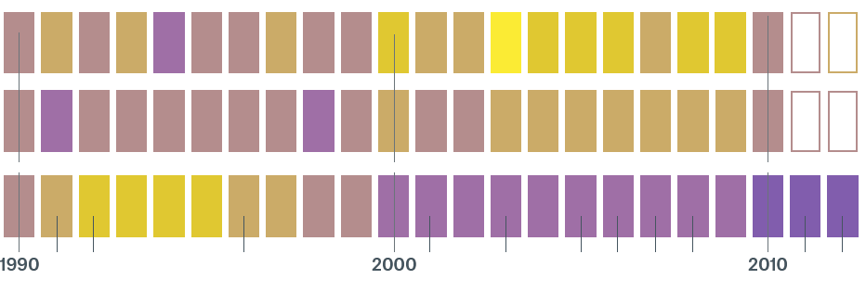
EUTROPHICATION
GOOD
FERTILISER: NITROGEN
FERTILISER: PHOSPORUS
OXYGEN
BAD

Slide 11
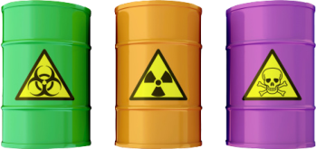
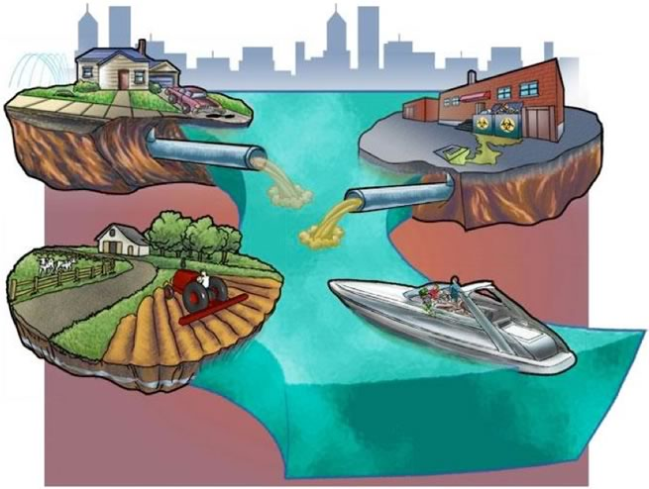
DANGEROUS CHEMICALS

Slide 12
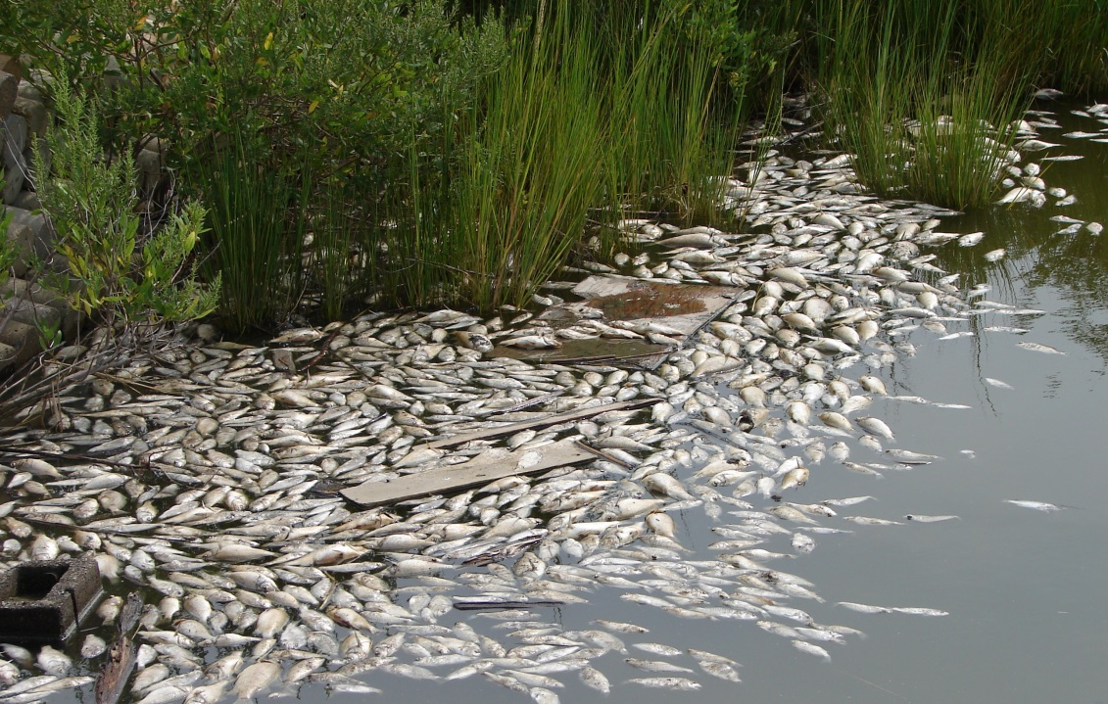
HAZARDOUS SUBSTANCES
OR

Slide 13
HAZARDOUS SUBSTANCES

Slide 14
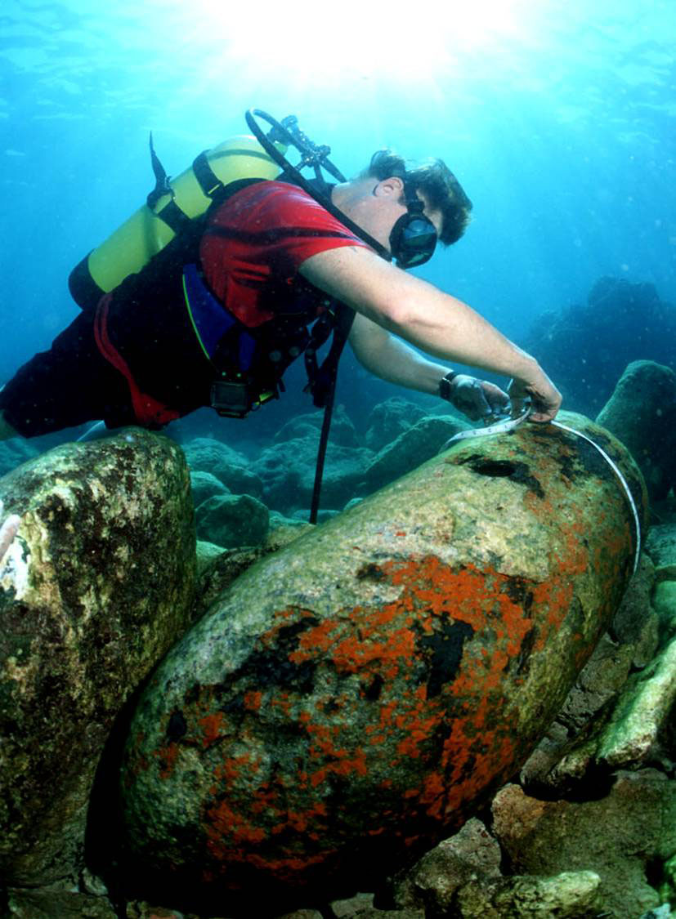
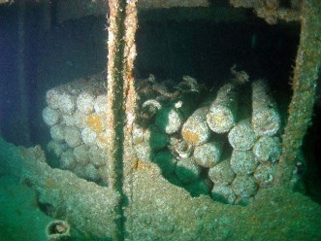
HAZARDOUS SUBSTANCES

Slide 15
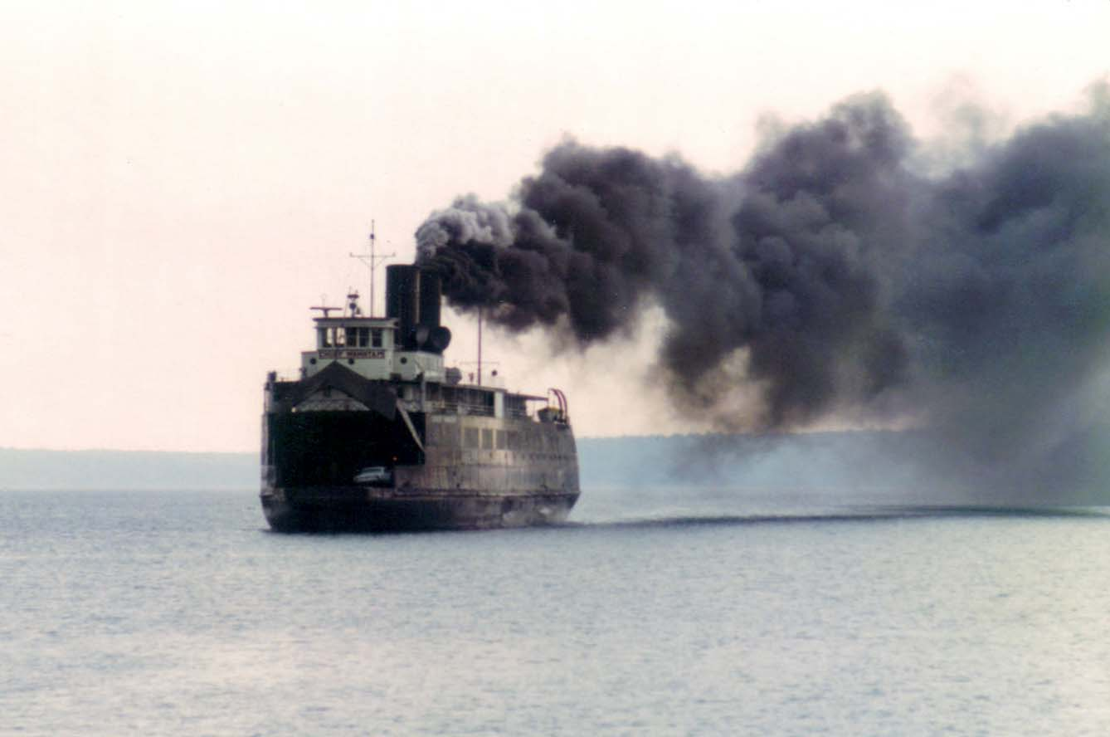
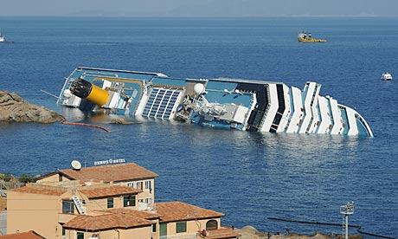
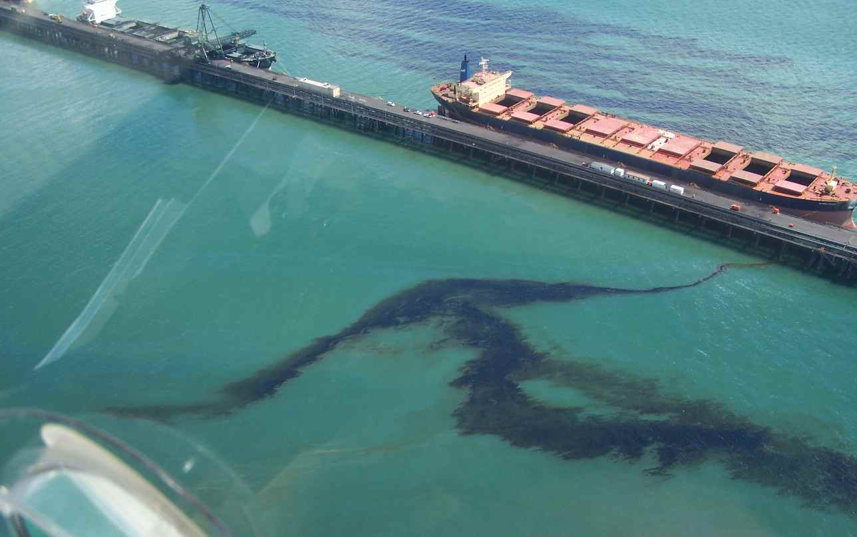
SHIPPING AND OIL SPILLS

Slide 16
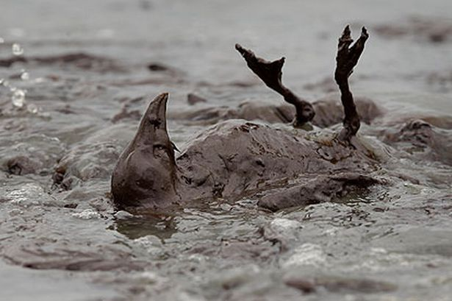
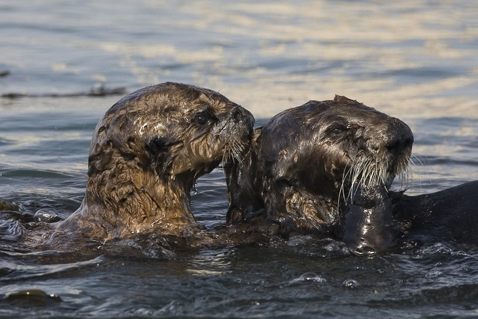
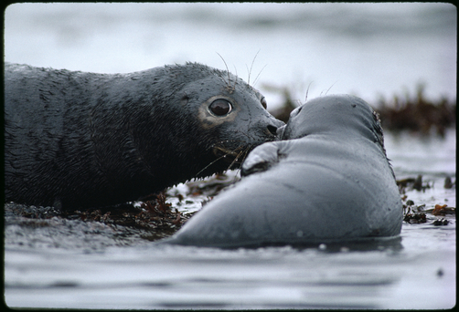
SHIPPING AND OIL SPILLS

Slide 17
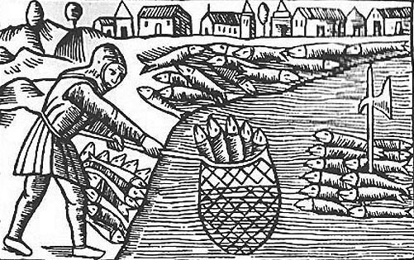
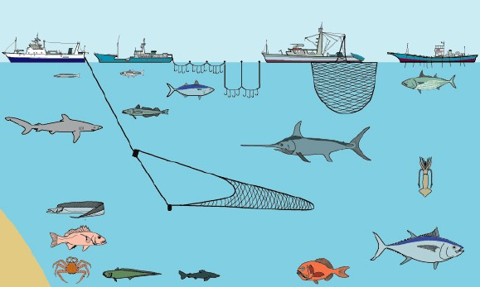
OVERFISHING

Slide 18
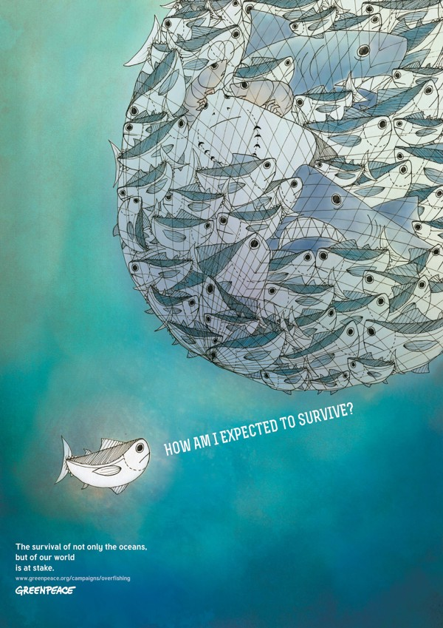
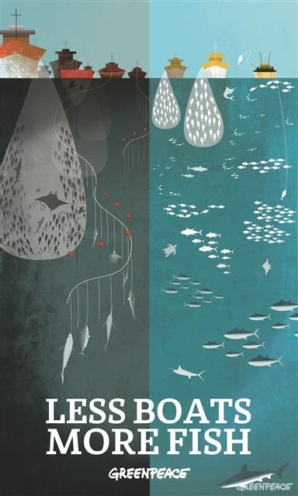
OVERFISHING

Slide 19
MARINE LITTER

Slide 20
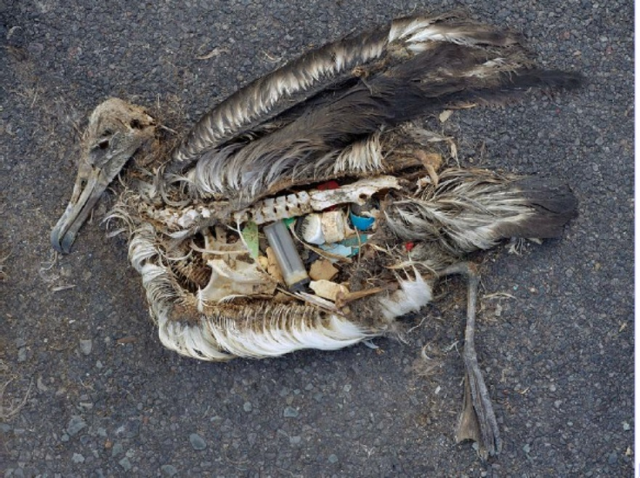
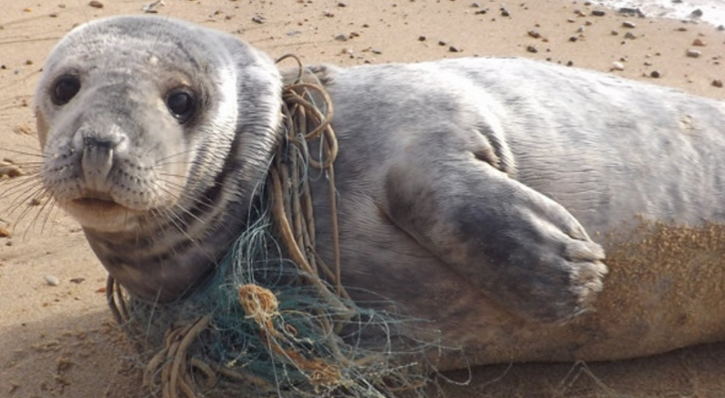
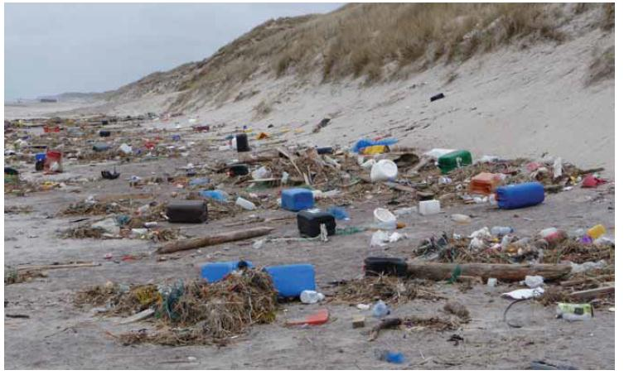
MARINE LITTER

Slide 21
CONCLUSIONS
CHANGES DUE TO GROWTH OF THE POPULATION
INCREASED PRESSURE ON THE SEA
EUTROPHICATION
OIL SPILLS
HAZARDOUS SUBSTANCES
OVERFISHING
MARINE LITTER
CLIMATE CHANGE

Slide 22
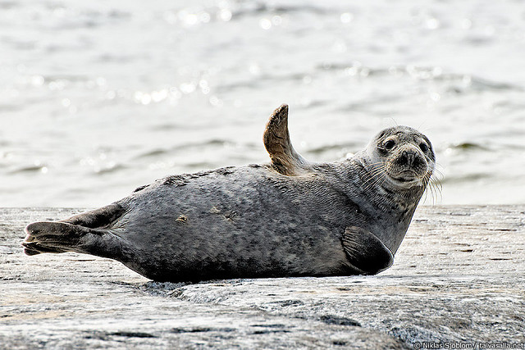
THANK YOU!

