Slide 1
Composition of species and number of population of chosen species of birds In the Bay of Gdańsk and near Kościuszko Square
Aleksandra Gładka, Kinga Muza

Slide 2
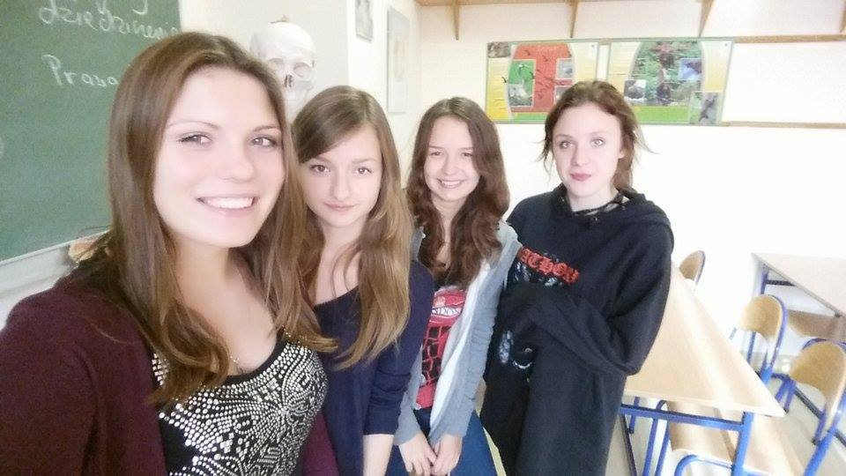

Slide 3
Research problem: Which anatidae or gull birds occur often in the winter time in the given area?
Hipothesis: In the Winter time there are more gull girds than anatidae birds and other spiecies occur occasionally.
The aim of the research: Our goal was to get acquainted with the bird species that spend winter in the area of Kościuszko Square and to compare their number.

Slide 4
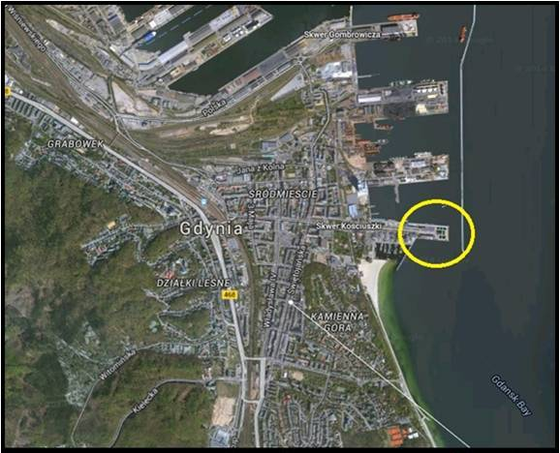

Slide 6
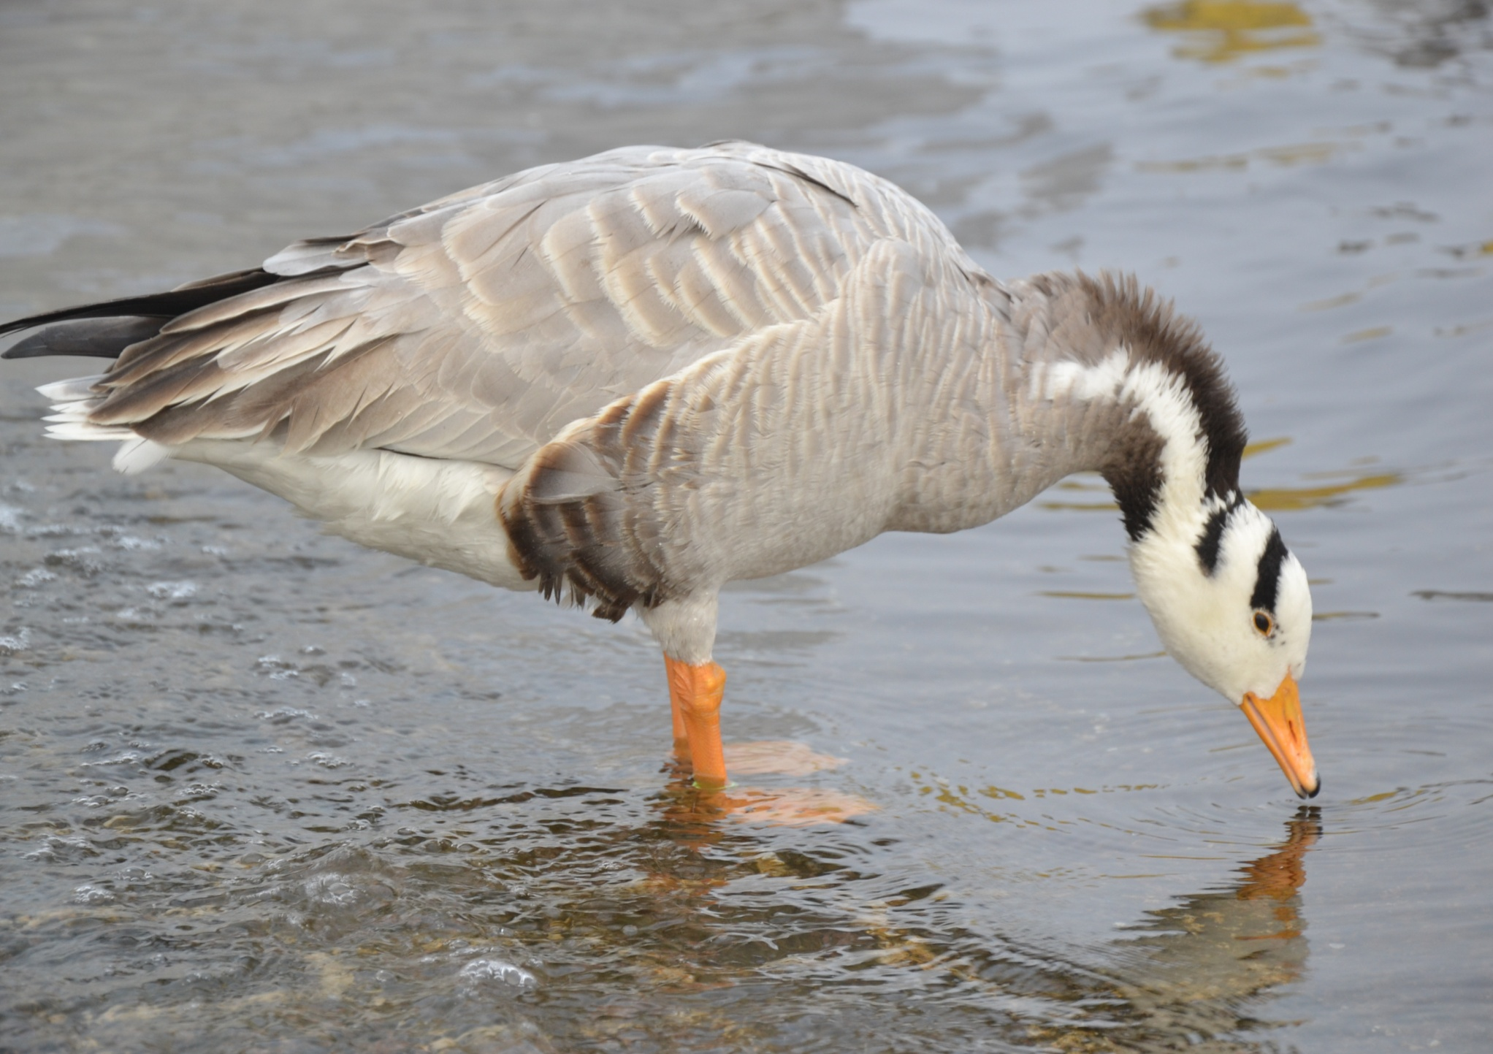

Slide 10
Conclusion: In winter, there are a lot more gull birds than anatidae birds because gull birds have no problem with gaining food due to the fact that they mainly feed on fish. Whereas the anatidae have smaller access to their food. In addition, ducks are often fed with bread by humans which leads to causes deaths and illnesses. Bread, which they eat, is frequently stale and mildew in birds’ stomachs. Other species of birds that occur in winter are Great Cormorants and Bar-Headed goose. These geese are not typical species to be found in the Baltic Sea area but in the area of Central Asia.

