Slide 1
Healthy food. Healthy life.
Prof. Danuta Nabiałkowska
Małgorzata Rymarczyk
Marek Rojek
Pratrycja Rumin
Zuzanna Gaik
Marcin Bartosiak
9th International Conference of the UNESCO Baltic Sea Project "Science of Changes"
Konopnicka Upper Secondary School in Katowice, Poland

Slide 2
Healthy life
The main aim of healthy lifestyle is to maintain good state of body due to balanced and healthy diet as well as by regular sport activities.
In addition, regular and not too excessive sports activities ensure healthier life.

Slide 3
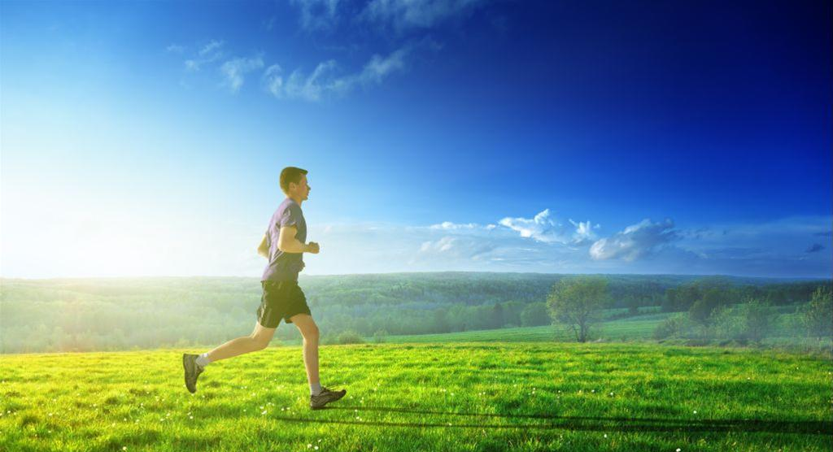
Phisical activity in Poland

Slide 4
66%- are practicing various kinds of sports during a year
40%- are practicing sports regularly
26%- are practising sports occasionally
Sports are practiced especially by a well-educated, young, wealthy citizens.

Slide 5
The most popular activities:
51% - cycling
28% - swimming
18% - jogging
16% - walking
14% - football, volleyball
13% - gymnastics, fitness, aerobic
Personal abilities:
97% - cycling
64% - swimming
51% - ice skating
30% - skiing
Frequency of training sports:
Predominantly: gymnastics, fitness, aerobic, cycling. Other sports are practiced rather occasionally.

Slide 6
Why does polish people do sport?
Motivations:
70% - improved health condition (due to: jogging, swimming)
61% - fun (skiing and other type of winter leisure activities)
47% - improved state of mind, stress relive,

Slide 7
Well balanced diet
So-called well balanced diet should not exceed individually calculated daily energetic values but provide all necessary ingredients and micro-elements. Such elements are: protein, fats (including vegetable fat), carbohydrates, omega 3 and 6 as well as macro and micro elements.
Typically, 3 to 5 meals a day should be consumed, making most of the daily energetic value divided in the following way: 40% Dinner, breakfast 30%. We should provide most of the daily energy by eating complex carbohydrates and leguminous plants. We should also eliminate any plain carbohydrates. Note that 25 to 30 % should come from fats and 10 to 15 % from proteins. Despite all above, we should also consider the acidic and alcaline balance due to the fact of meat-based products are producing lots of acid where vegetables and fruits are producing more alcali. Thus, the vegetables and legumes should be consumed in larger portions.
In short, we need to remember to eat Eco food!

Slide 8
Eco food
The term Eco food is strictly defined by law and can be used only to describe products which meet the rigorous production requirements. Eco food must contain a minimum of 95% of natural ingredients. Eco food products are not genetically modified, and do not contain any pesticides, or other chemicals that influence growth or storage of such products. In addition, farm foods and their products are regularly going through assessments.
Since 2004, production of eco food in Poland is controlled by EU law and legislations. Please refer to EEC number 2092/91. Eco product needs to have a special EKO sign on its label. ECO sign is the guarantee of quality, so the consumer can be sure that given type of food was produced according to the rules and was controlled by experts.

Slide 9
Avability of the Eco food
Earlier in history of eco food - such products were only available in selected exclusive shops and groceries. Currently, the situation is much better and eco food is available in most major malls. Eco food market is currently one of the fastest growing food markets across the entire world. An average anual increase has been around 20% since the 90s.

Slide 10
Interest in Eco food
Recently, consumers are expressing interest in allergic free products as well as in products without taste amplifiers or preservatives. The interest in eco food and drink products is growing around the whole world for a various reasons.
Conscious decisions are often made based on a need for ongoing improving of your own health. Current consumer more and more often seeks for nutritional values at the same time respecting the taste, ECO label and origin of such product. Shop assistants are often asked about harmful ingredients, people more willingly buy traditionally prepared sausages, bread, natural cheese, eco-grown vegetables, freshly squeezed juices or jams from fruit without pesticides, or non-pasteurised beer. Unfortunately, knowledge about the products needs to be kept up to date on a frequent basis to keep up with customers’ demands for expertise.

Slide 11
Diet change process
It is true, changes in a diet habits are not an easy or short process as they require long term involvement and continuous small changes in our eating and living habits. Balanced diet events in local supermarkets and malls are the most influential ones due to number of customers. An awareness of balanced diet can be also increased by form of social events, interviews or school classes. Mentioned methods were shown to be one of the most effective in increasing the awareness of well balanced diet. Other well-known, however more time-consuming, method is increasing the awareness by involving pupils in whole process of growing and then making food. Apart from schools, large number of people are attracted to terms ‘balanced diet’ and ‘fruits and vegetables’, if an event is organized in their workplace thus increasing sales of healthy snacks and other products. Such increase in the interest could finally facilitate lowering price of eco products.

Slide 12
Traditional Polish dishes
Most popular Polish dishes are: `pierogi` (similar to ravioli), Silesian dumplings, rolled cabbage with filling called `gołąbki`, pork chops, `bigos` – a dish made of sauerkraut, meat and mushrooms, various soups and meat dishes prepared in different styles. Marine fish and freshwater fish are less popular. A specific Polish dessert is called `faworki` (deep fried sweet pastry), but also other kinds of pies and cakes such as pound cake, cheesecake, gingerbread or doughnuts.

Slide 13
Our dishes
Pierogi - Dumplings
Gołąbki – pork chops

Slide 14
Bigos
Faworki

Slide 15
Żurek - soup
Kluski Śląskie – Silesian Dumplings

Slide 16
Polish cousine today
Potatoes are the basis of our cuisine despite the fact they are very caloric (energetically), we also eat a lot of pork and chicken. Tomatoes, red peppers, onion, and garlic are also very popular as presented on a slide. Examples of regional influences on our cuisine are: marine fish from Pomerania, dairy products from the Tatra Mountains as well as mushrooms from Wielkopolska region. In short, each region has their own menu. There are also differences in the names of the same products and dishes across country.
Traditional Polish specialities are full of calories. Polish cuisine is famous for fatty dishes, mainly from meat, we bake great bread and make delicious sausages. Tradycyjne polskie specjały to prawdziwe bomby kaloryczne. Kuchnia In short, each region has their own menu. There are also differences in the names of the same products and dishes across country.

Slide 17
Diagram compiled out of questionaire

Slide 20
(Events are) increasing awareness in young’s’ people minds in regards to healthy lifestyle and its impact on own comfort
(Events are ) advertising healthy life style as well as popularize the need for health food and well balanced diet
Such (healthy) meals are an interesting alternatives to standard meals typically available in schools or workplace.
There should be more and more of such social initializes, as they are needed and interesting.
It is also a great social initiative.
Pupils from our school agreed that more and more such actions should be conducted, as shown on a diagram.
We need more events which will increase the awareness and show the impact on the one’s life.

Slide 21
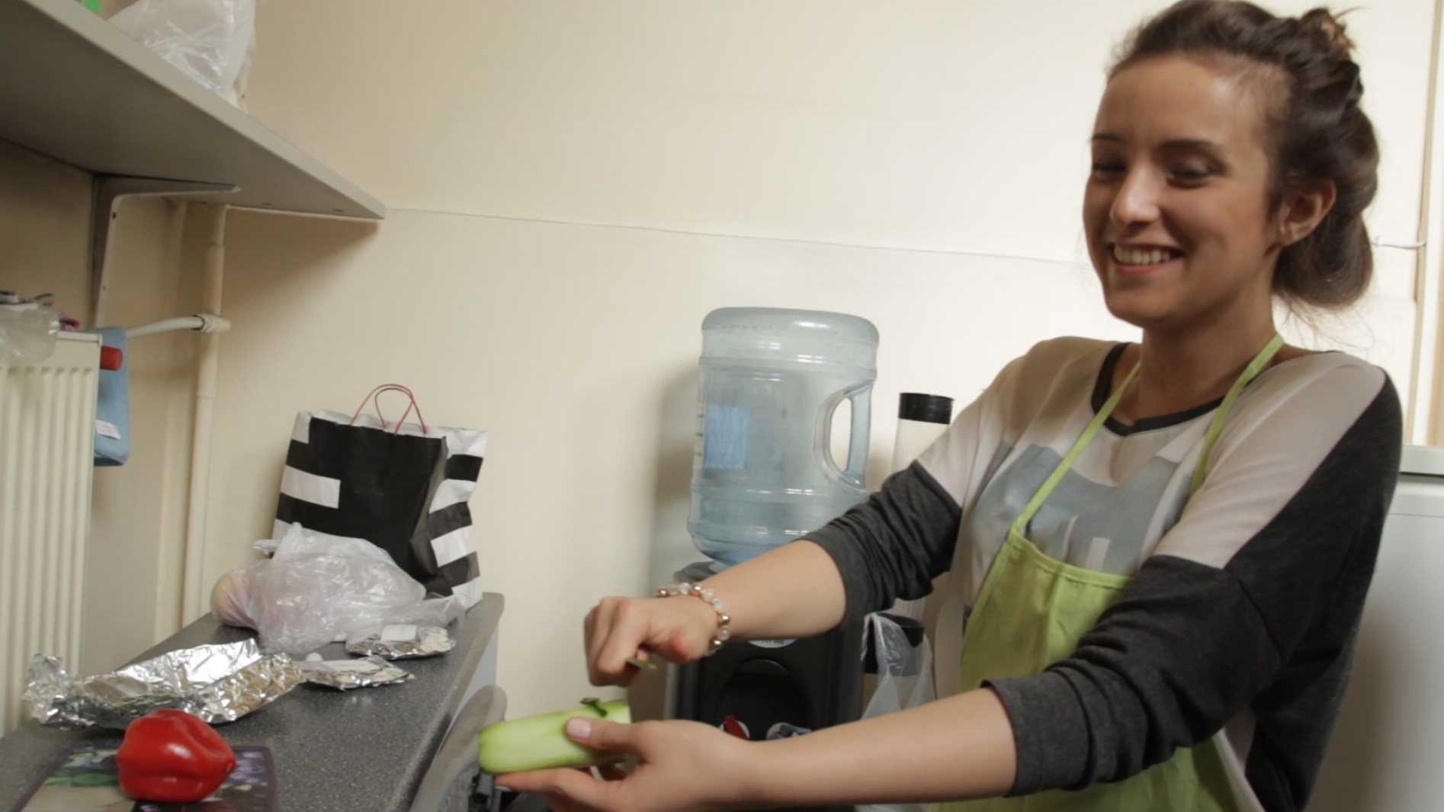
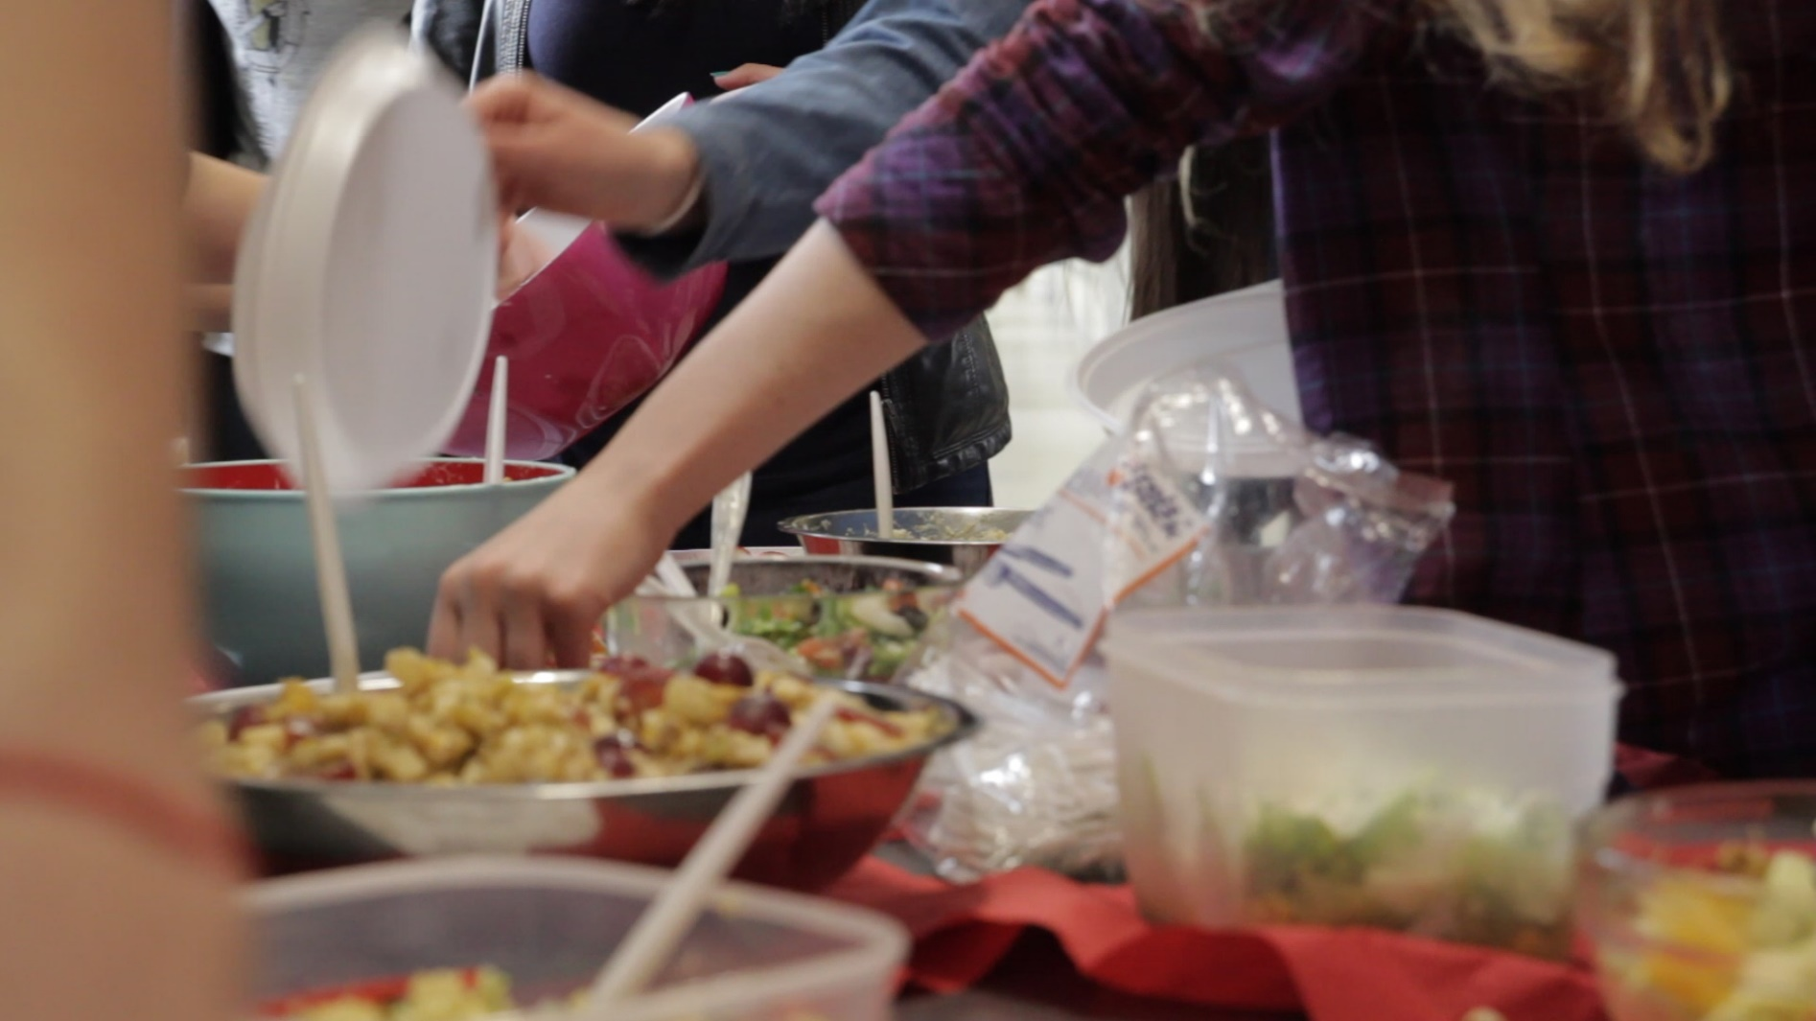
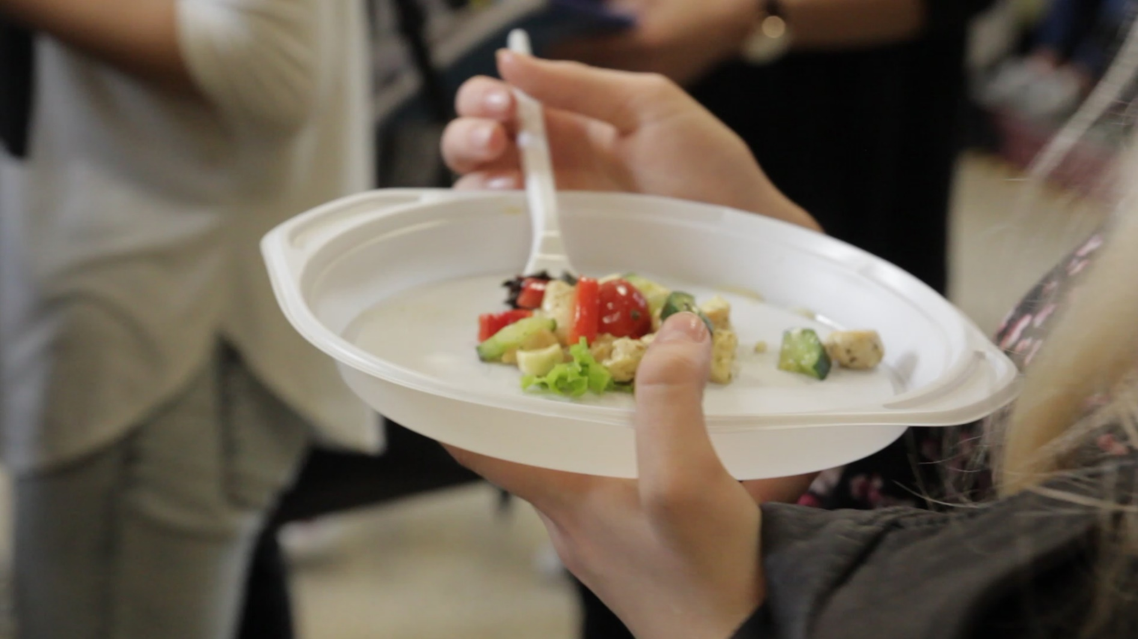
Photos from our action

Slide 22
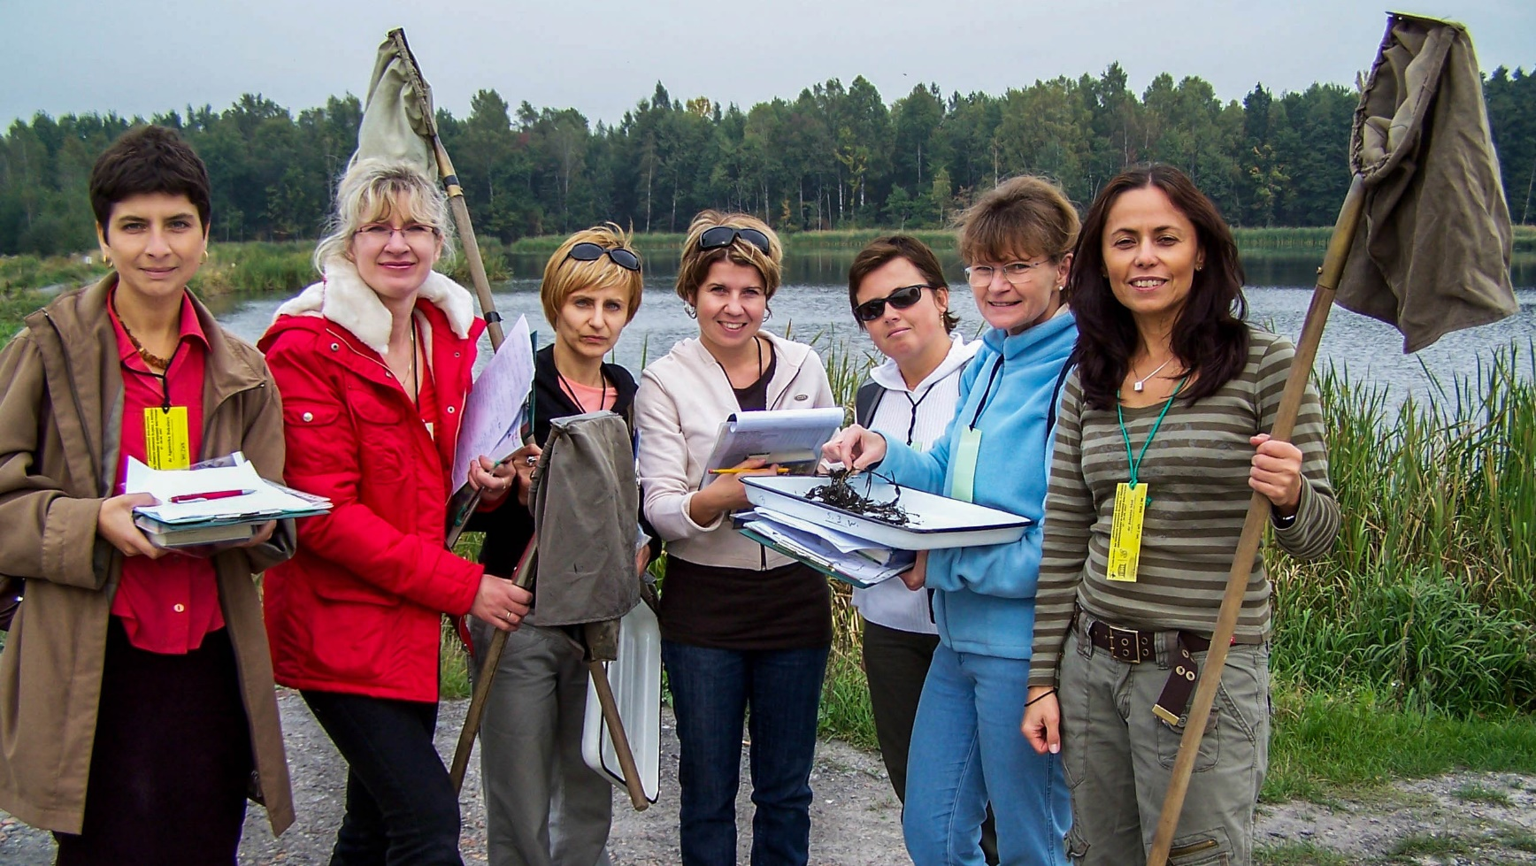
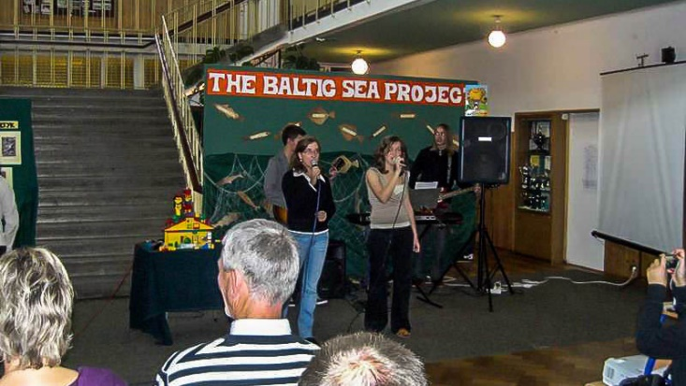
Our previous BSP conferences

Slide 23
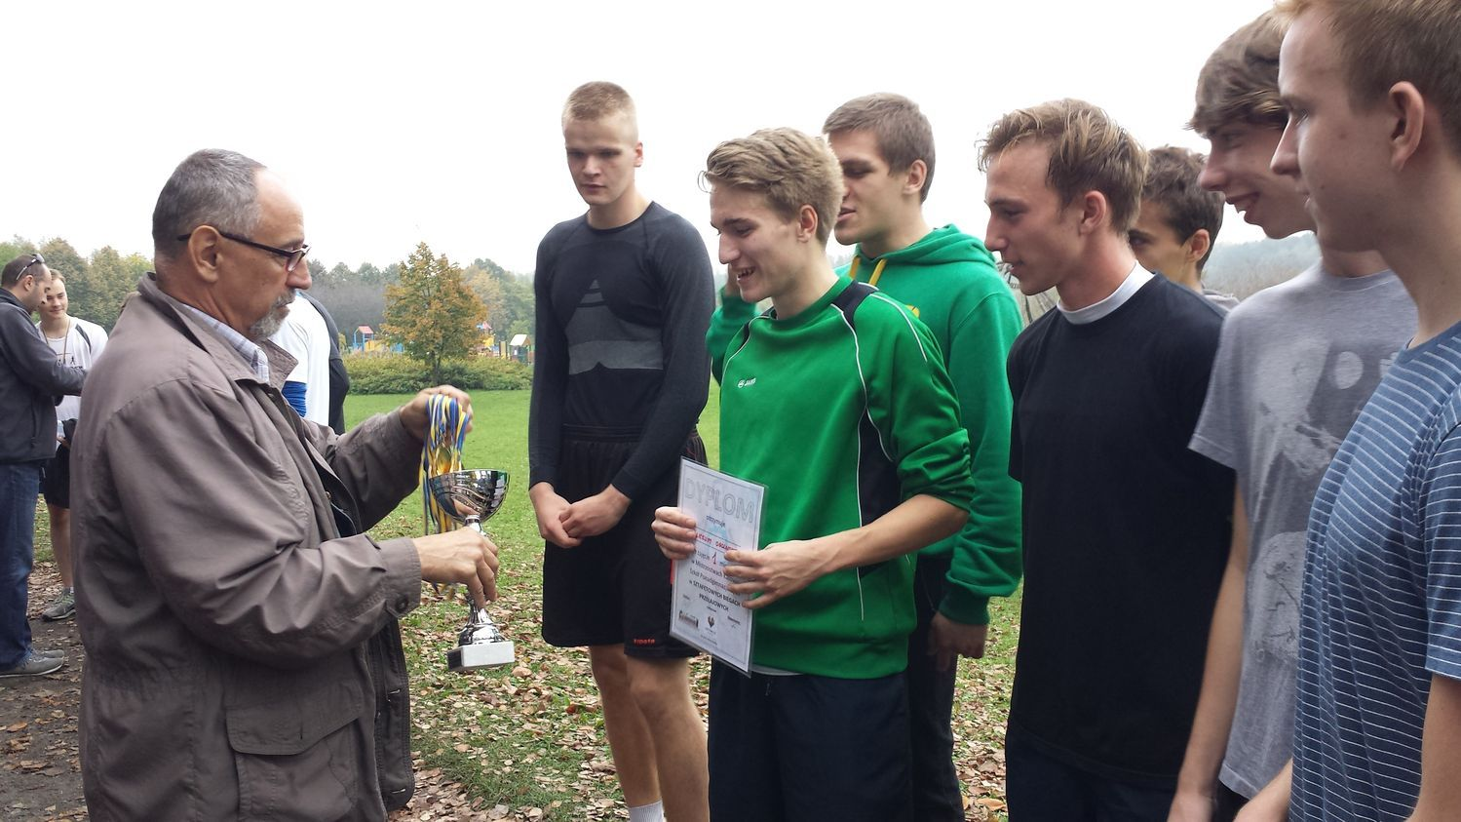
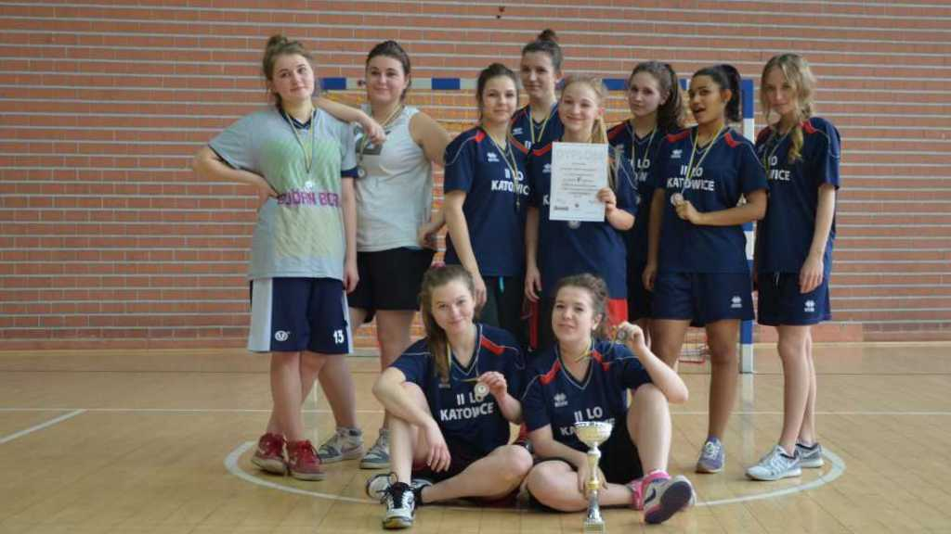
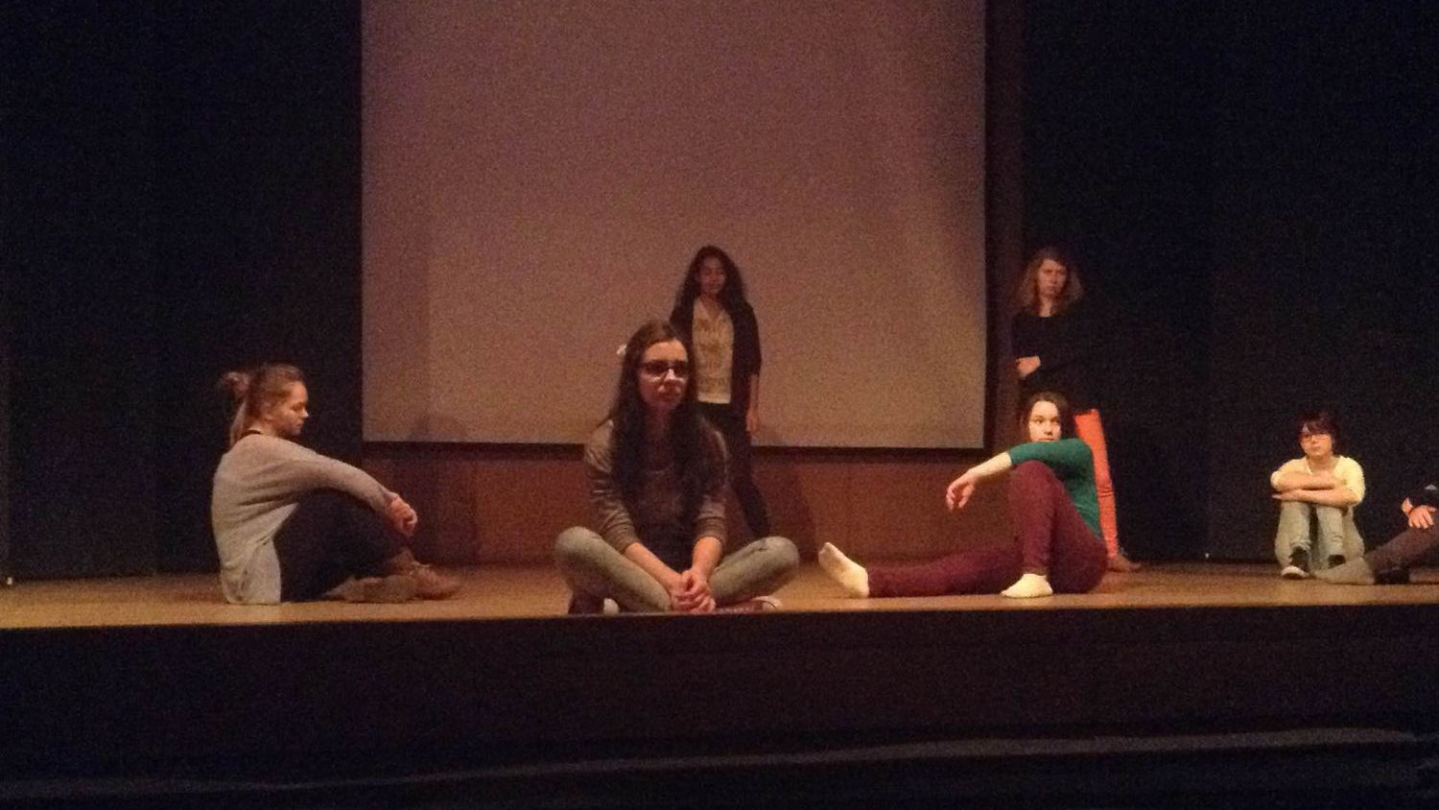
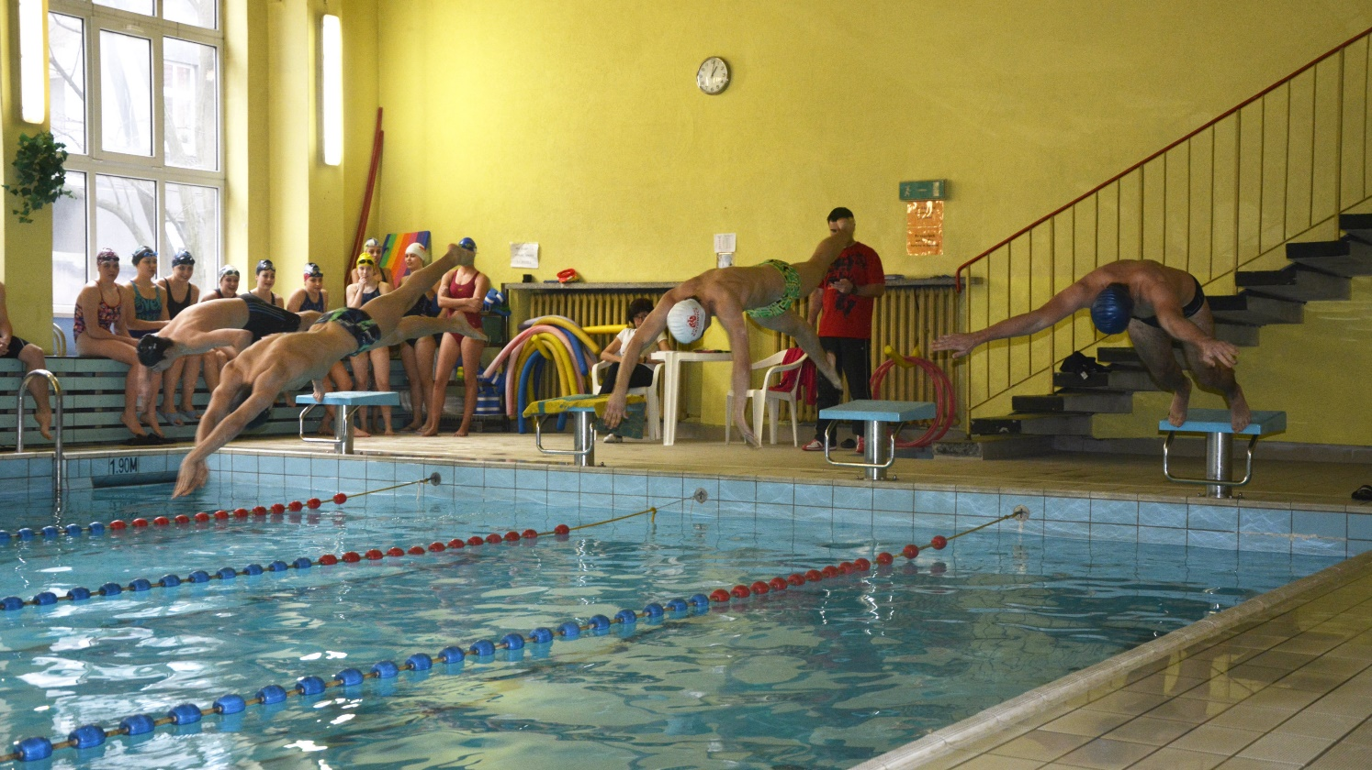
Other healthy life events in our school

Slide 24
We want to encourage others to the healthy and well-balanced diet awareness programme!
Watch this - our pupils are already benefiting from it!

Slide 25
Bibliography
http://www.cbos.pl/
Szymańska K., Żywność ekologiczna – rozwój a potrzeby społeczeństwa; [w:] Rola dokonań młodych naukowców a możliwości osiągnięcia sukcesu naukowego i zawodowego” pod red. Kuczera M., wydawnictwo: CREATIVETIME, Kraków 2011.
portal.abczdrowie.pl/zywnosc-ekologiczna
http://www.staypoland.com/kuchnia-polska.htm

Slide 26
Thank You!
Prof. Danuta Nabiałkowska
Małogrzata Rymarczyk
Marek Rojek
Patrycja Rumin
Zuzanna Gaik
Marcin Bartosiak

