Slide 1
Sailing Ships on the Baltic Sea
Luulea Lääne
Communication Director
AS Tallink Grupp

Slide 2
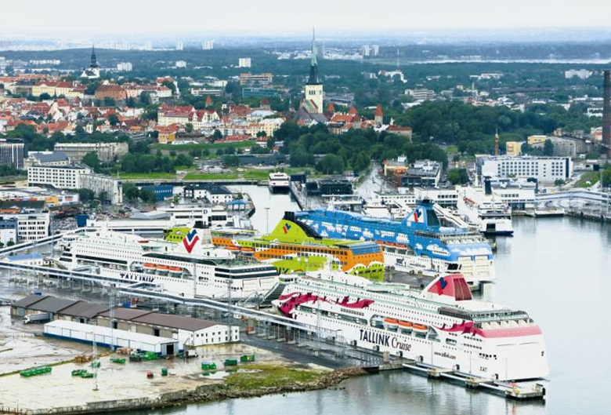
Tallink is the leading European provider of leisure and business travel and sea transportation services in the Baltic Sea region
Fleet of 17 vessels
Operating five hotels
Revenue EUR 921 million
EUR 1.7 billion asset base
Nearly 7000 employees
8.9 million passengers annually
310 thousand cargo units annually
Listed on Nasdaq OMX Baltic – TAL1T

Slide 3
Unrivalled suite of competitive advantages
1
7
Modern fleet
2
Extensive Sales Network
10 core vessels have an average age of 11.8 years
Ice class vessels
Luxurious on-board experience, e.g. spacious shopping areas
Extensive route network
21 own sales offices
Network of >1,800 travel agents and tour operators worldwide
Growing online presence and call centres
Variety of short cruises between key cities
Optimised schedules with frequent and reliable departures all year
Established relationships with port authorities
6
1
3
Comprehensive offer
Strong quality brands
Varied on-board experience
Travel packages and excursions
Addressing all budget ranges and customer preferences
Silja Line and Tallink are the most recognised cruise brands in the Northern Baltic Sea Region
They are associated with a quality customer experience
1
1
1
Sweden
Estonia
Finland
47% Market share of the Northern Baltic Sea Region passenger market
5
4
Loyal customer base
High safety and environmental standards
8.9M passengers in 2014
Nearly 1.8 million Club One card holders growing at 11% in 2014
Every third passenger is a club one member.
We proactively seek compliance with the highest standards
In 2014, only 2 of the over 9000 scheduled trips were cancelled for technical reasons

Slide 4
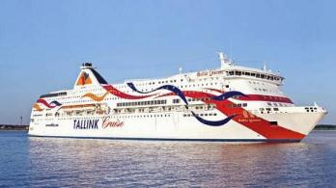
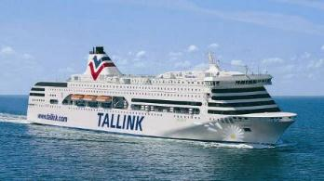
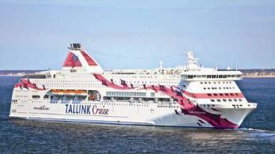
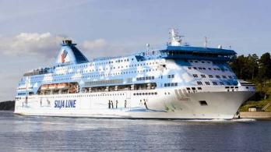
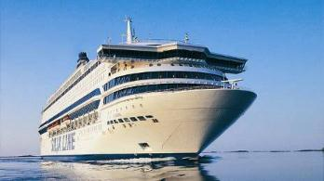
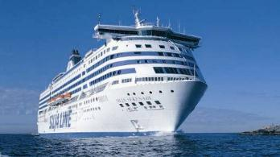
Tallink has invested 1.3 billion EUR to create a modern fleet
Baltic Queen
Built: 2009
Length: 212m
Passengers: 2800
Lane meters: 1130
Victoria I
Built: 2004
Length: 193m
Passengers: 2500
Lane meters: 1030
Tallinn-Helsinki
Tallinn-Stockholm
Baltic Princess
Built: 2008
Length: 212m
Passengers: 2800
Lane meters: 1130
Galaxy
Built: 2006
Length: 212m
Passengers: 2800
Lane meters: 1130
Turku-Stockholm
Turku-Stockholm
Silja Serenade
Silja Symphony
Built: 1990/91
Length 203m
Passengers: 2852
Lane meters: 950
Silja Europa
Built: 1993
Length: 202m
Passengers: 3123
Lane meters: 932
Chartered out
Helsinki-Stockholm

Slide 5
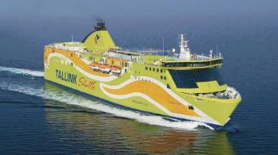
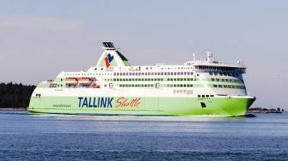
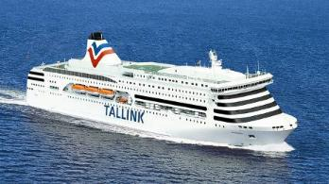
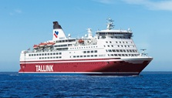
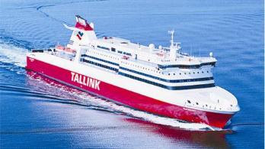
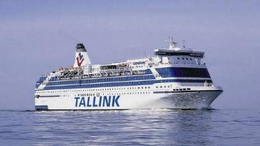
In addition the Group has 2 ro-pax cargo vessels in operation
Superstar
Built: 2008
Length 177m
Passengers: 2080
Lane meters: 1930
Star
Built: 2007
Length 186m
Passengers: 1900
Lane meters: 2000
Tallinn-Helsinki
Tallinn-Helsinki
Romantika
Built: 2002
Length 193m
Passengers: 2500
Lane meters: 1030
Isabelle
Built: 1989
Length 171m
Passengers: 2480
Lane meters: 850
Tallinn-Stockholm
Riga-Stockholm
Superfast VII/VIII/IX
Built: 2001/2002
Length: 203m
Passengers: 717
Lane meters: 1924
Silja Festival
Built: 1986
Length 171m
Passengers: 2023
Lane meters: 885
Riga-Stockholm
Sold, delivery in June
Chartered out

Slide 6
Environmental policy
The principles of environmental protection are integrated into the company`s main strategy
The environment is protected against marine-, air and other pollution
Ships are maintained and operated according to the MARPOL convention
The ships have the high level international environmental certificate ISO 14001:2004
The company is preffering environmentally aware and certified cooperation partners

Slide 7
Protecting Baltic Sea
Safety Management System (SMS) follows all requirements of IMO and other international organizations and authorities
Waste (grey, black) and oily waters (sludge) – are cleaned on board, taken on shore
Used cleaning chemicals – biochemicals
Cleaning of the ships hull – done by divers, ships are painted with environmental friendly paints
Informing passengers

Slide 8
Protecting air environment
Ships use 0.1% low sulphur fuel
Ships use fuel supplements, which diminish the soot percentage in the exhaust gases
Most of ships have catalytic converters, which are effective means of decreasing the NOx percentage in exhauste fumes (90-99%)
Using certified spare parts on ships
Operating energy efficiently (schedules, speed)

Slide 9
Protecting land environment
Energy efficient operations (in offices)
Controlling of the noise level in harbour areas
Waste sorting in offices and on board of ships
Recycling
Tallink Hotels follow the Green Key principles
Preffering environmentally aware cooperation partners

Slide 10
Tallink`s environmental certificates
ISO 14001:2004 environmental certificate by Lloyds Register
MARPOL Sewage Pollution Prevention Certificate
MARPOL Air Pollution Prevention Certificate
IAFS International Anti-Fouling System Certificate
MARPOL Oil Pollution Prevention Certificate
Document of Compliance for Anti-fouling System
MARPOL Garbage Pollution Prevention Attestation

Slide 11
Safety on board
To prevent any danger and accidents SMS system is used, which is audited annually
Following IMO and other international standards and requirements
Strict order in the ships technical maintenance
Maximum number of safety equipment on board
Frequent safety exercises, training of the employees

Slide 12
Tallink`s safety certificates
Document of Compliance by Lloyds Register
Document of Compliance by Estonian Maritime Administration
Document of Compliance by Finnish Maritime Administration
Document of Compliance by Swedish Maritime Administration
Document of Compliance by Latvian Maritime Administration

Slide 13
We Engage!
Thank you for the attention!
www.tallink.com

